Slide 1
rideroundup
FRONTEND DIRECTION · AUGUST 2026
Website design
& screen walkthrough
Nine screens showing how the RideRoundUp specification looks and behaves — built from the strategy thesis, the product vision, the UI feedback and the team ideation notes.
Prepared for the development team · Companion to the written build specification
Notes:
This deck is the visual companion to the written specification. Every screen here is a real rendered design at 1440x900, not a wireframe — the intent is that the dev team can see exactly what they are building.

Slide 2
WHERE THIS DESIGN COMES FROM
Four documents, one build
Each source contributed something the others were missing. The design below is the merge — not a compromise.
Strategy thesis
Product vision
Paras’ UI feedback
Team ideation notes
Discipline
The feature list
The standard
The differentiator
UAE first on a multi-market architecture. Phase 1 stays narrow: discover, compare, decide, connect.
29 modules become a sequenced backlog. Nothing was deleted — items moved to later phases.
Navbar, spacing, logo, font, card USPs, hover gallery. All seven points are launch blockers here.
Running cost and hidden cost in Dubai. This became the spine of the whole design.
THE ONE DECISION EVERYTHING ELSE FOLLOWS
Cost honesty is the product, not a feature.
No competitor in the region shows what a car actually costs to run and register. Every screen in this deck carries that idea — the card, the listing, the comparison, the assistant. It is cheap to build, impossible to fake, and it is the reason a first-time buyer trusts us over DubiCars.
Notes:
If the team remembers one thing from this deck, it should be this slide. The visual identity exists to serve the cost-transparency idea.

Slide 3
DESIGN SYSTEM
The visual language
Deliberately not automotive red-and-black. Deep petrol carries the trust, amber is reserved almost entirely for cost information.
Typography
AED 285,000
Display — geometric sans with tabular figures. A price column set in proportional numerals looks broken.
Petrol
Deep
Amber
Green
Rust
Mist
Primary
Headers
Cost only
Verified
Alerts
Surfaces
Body sits at 14px / 1.5 on a strict 9-step scale. Arabic uses a weight-matched companion, not a fallback.
#0D3B49
#072830
#E8942B
#12805C
#C4451D
#F4F6F7
THE SIGNATURE ELEMENT
Rules that cannot be broken
The receipt
—
No price renders without its date. Enforced in the price component itself.
One repeated device carries the brand: an itemised, dashed-rule receipt showing every dirham. It appears on cards, listing pages, comparisons and the phone. When someone describes RideRoundUp to a friend, this is the thing they describe.
—
Sponsored placements are labelled and capped at one in eight results.
—
The assistant answers from our data or says it does not know.
—
Six nav items, 64px tall. Fewer items, never smaller type.
—
WCAG 2.1 AA, full RTL, reduced-motion respected on the card gallery.
Notes:
Palette was chosen against the brief, not from a template. Amber is deliberately rationed so that when the user sees it, it always means money.

Slide 4
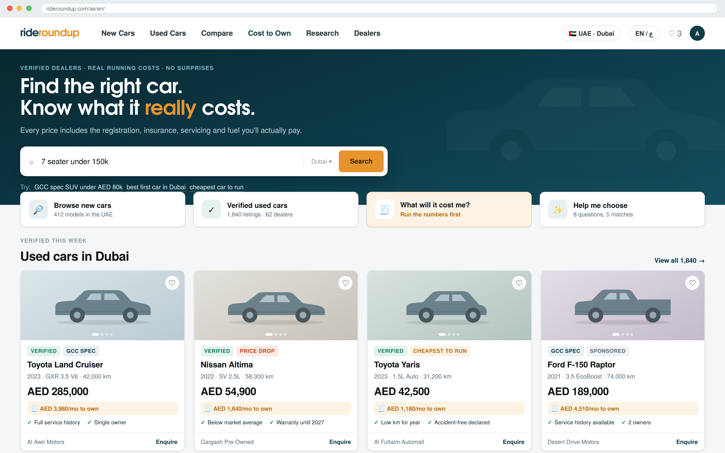
SCREEN 01
Homepage
The visitor picks one of four paths within eight seconds.
One promise, stated plainly
The headline commits to the differentiator instead of describing the category.
Search accepts real language
"7 seater under 150k" resolves budget, seats and market in one query.
Cards carry running cost
Every card shows monthly cost to own beneath the price — the amber row.
USP chips are derived
Generated from structured fields, never free text a dealer can write.
Notes:
Note the hero is a thesis, not a carousel. Carousels have near-zero engagement and wreck the LCP budget.

Slide 5
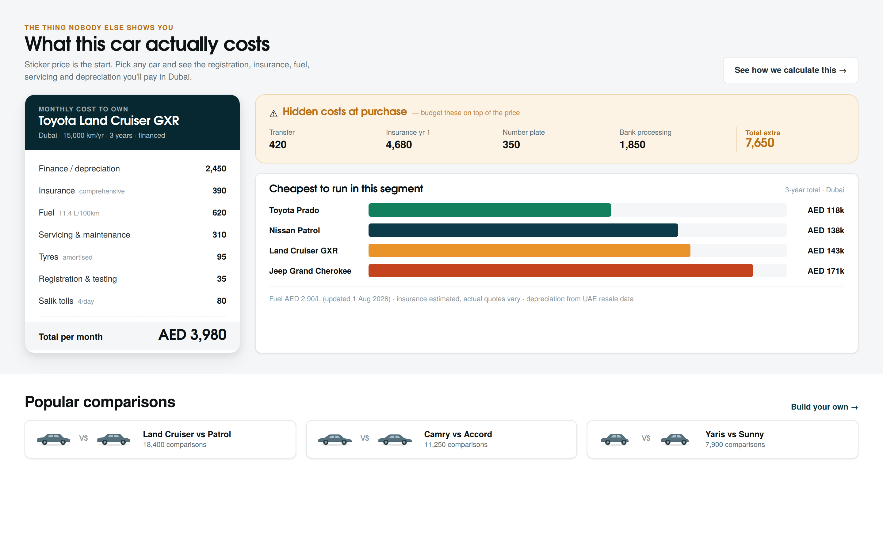
SCREEN 02
Cost to Own
The section no regional competitor has. This is the moat.
Itemised, not summarised
Seven line items, each adjustable, each with a visible assumption.
Hidden costs surfaced
Transfer, plate, first-year insurance, bank processing — AED 7,650 people get ambushed by.
Segment comparison
Turns a single number into a decision. Also generates thousands of long-tail SEO pages.
Sources and dates shown
Fuel rate, insurance basis and depreciation curve are all cited underneath.
Notes:
This is the slide to linger on. It answers the "how will we stand out from competitors" question from the team ideation notes.

Slide 6
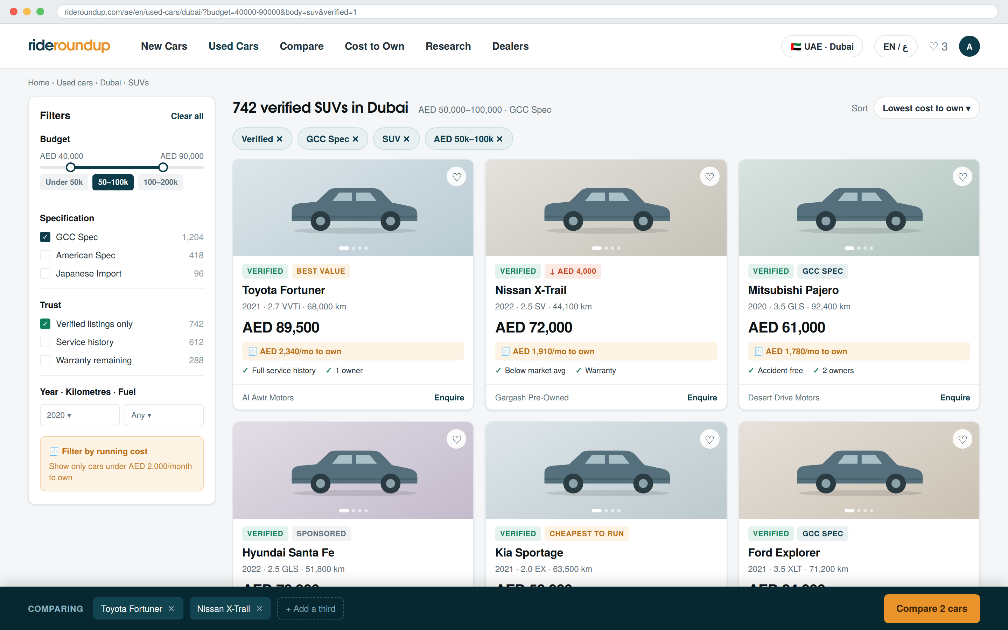
SCREEN 03
Used car search
Filters ordered the way people actually shop, not the way the database is structured.
GCC vs imported spec
A UAE-critical filter most global platforms omit entirely. It affects resale by double digits.
Sort by cost to own
A sort option no competitor offers, and the one first-time buyers want most.
Filters live in the URL
Results are shareable and back-button safe. Also indexable.
Comparison tray persists
Holds up to four cars across navigation, syncing to the account on login.

Slide 7
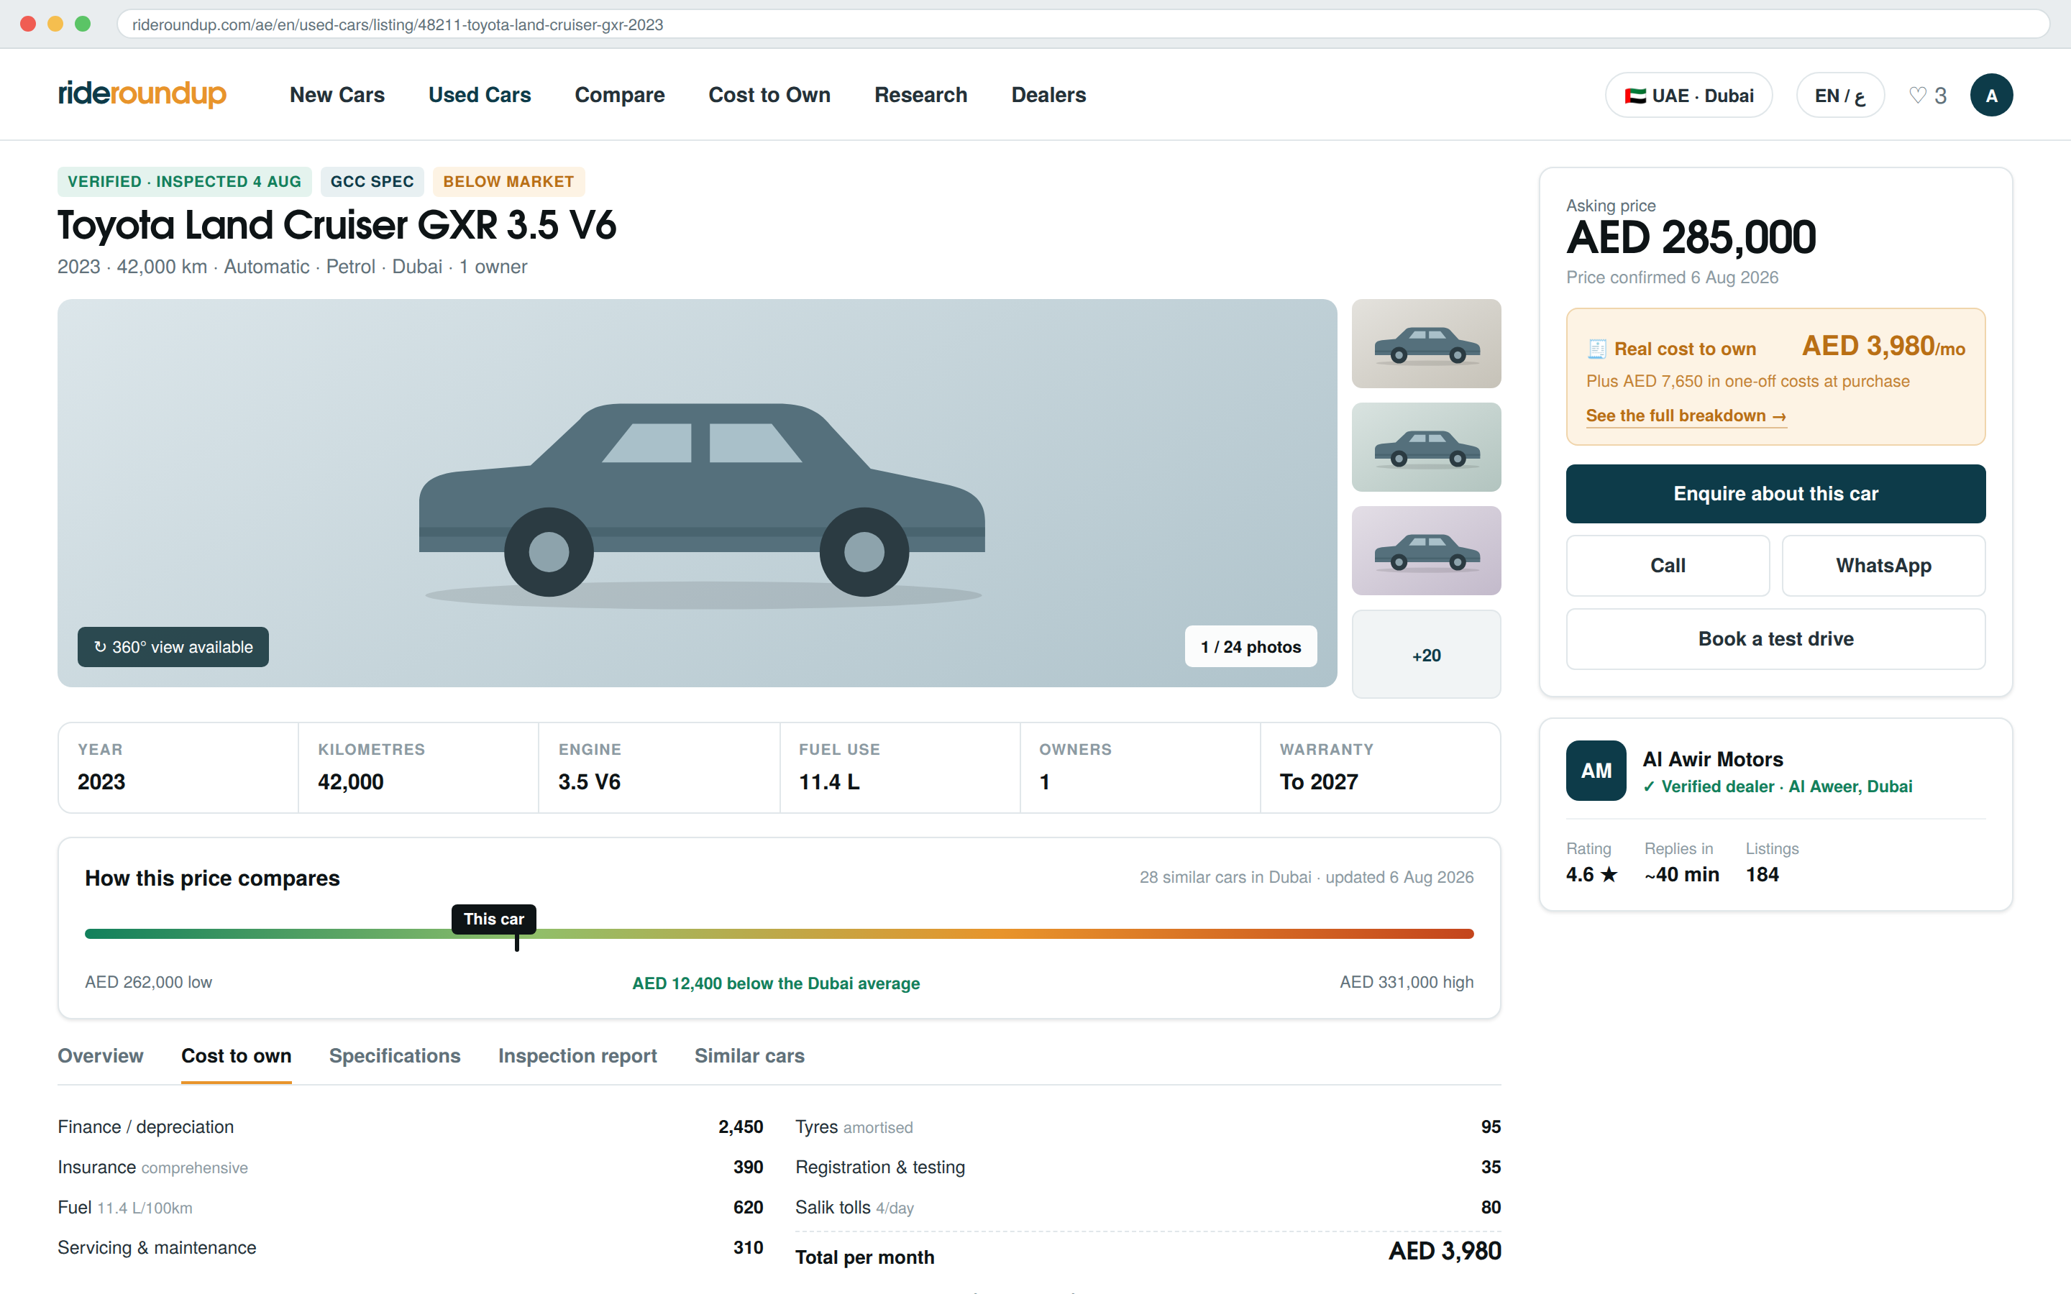
SCREEN 04
Vehicle detail page
Where the enquiry happens. Every trust rule in the spec is visible here.
Price with a confirmed date
If it ages past 45 days the UI says so rather than quietly showing a stale number.
Price in context
"AED 12,400 below the Dubai average", with the 28 comparables expandable.
Cost panel before the CTA
The buyer sees the true monthly figure before they are asked to enquire.
Dealer response time shown
Publishing the SLA is what makes dealers answer, and what makes leads worth paying for.

Slide 8
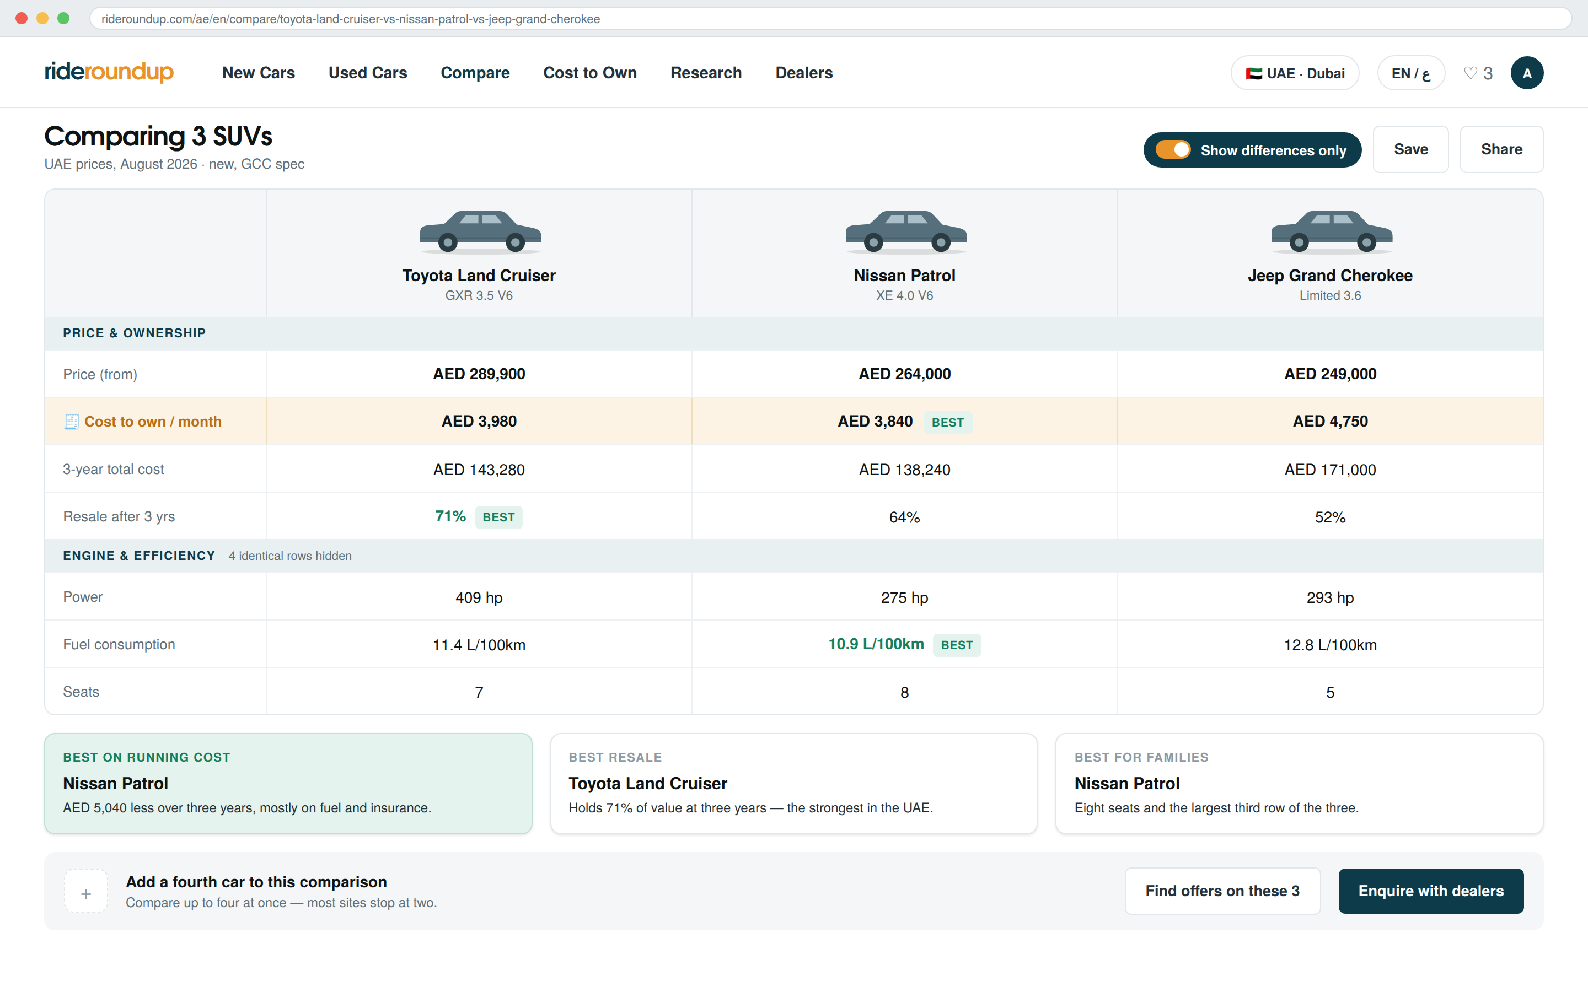
SCREEN 05
Comparison
Paras identified this as an underserved USP. Two changes make ours better.
Three and four cars, not two
The team notes asked for this directly. Most competitors cap at two.
Differences only
Collapses every identical row. The header shows what was hidden so nothing feels lost.
Cost to own is a row
Sticker price and running cost sit side by side and rank differently — which is the insight.
Verdicts are rule-based
"Best on running cost" comes from defined rules, never generated prose.

Slide 9
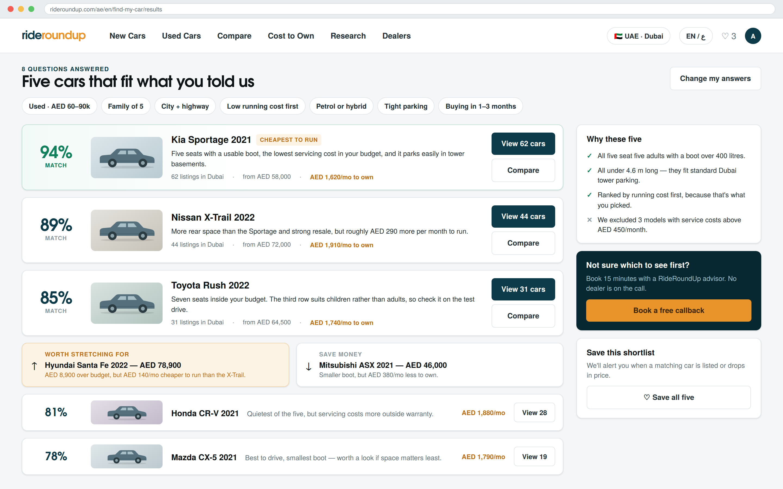
SCREEN 06
Guided car finder
Eight questions for the buyer who does not know what they want yet.
A match score with a reason
The percentage came from the team notes. The sentence beneath is what makes it credible.
Stretch and save options
One above budget with the delta stated, one below. Mirrors how people actually decide.
Exclusions are shown
Telling the user what we ruled out, and why, is what separates advice from advertising.
Advisor with no dealer on the call
Stated explicitly, because that is the whole value of the offer.

Slide 10
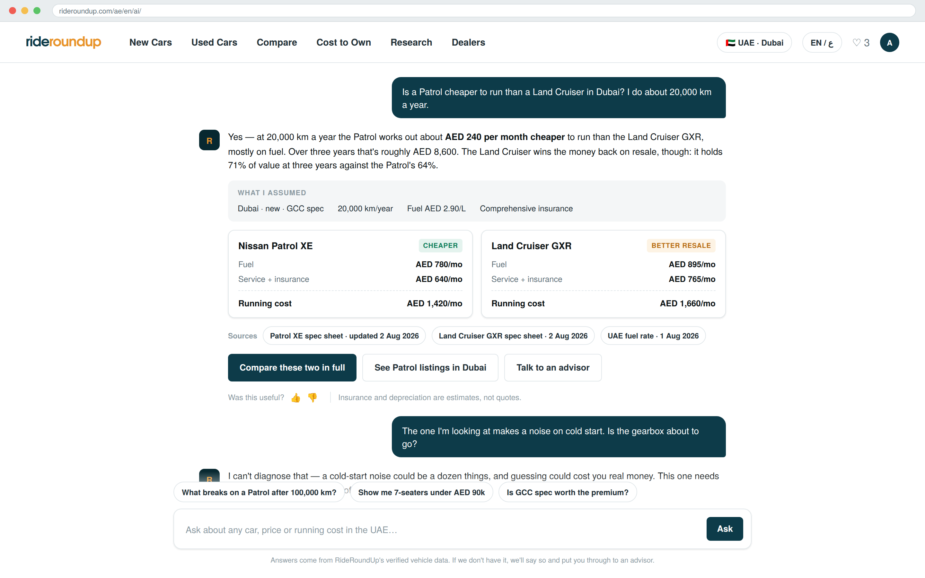
SCREEN 07
AI assistant
Retrieval-grounded. It cites its sources and refuses what it should not answer.
Assumptions made visible
Market, mileage, fuel rate and insurance basis are shown, not buried.
Sources with timestamps
Every factual answer names the spec sheet and the date it was verified.
It refuses diagnosis
The second exchange shows the guardrail: no mechanical diagnosis, escalate to a human.
Feedback creates tickets
A thumbs-down opens a content-gap task. The assistant doubles as product research.
Notes:
The refusal in the second exchange is deliberate and should survive to production. An assistant that guesses about a gearbox is a liability, not a feature.

Slide 11
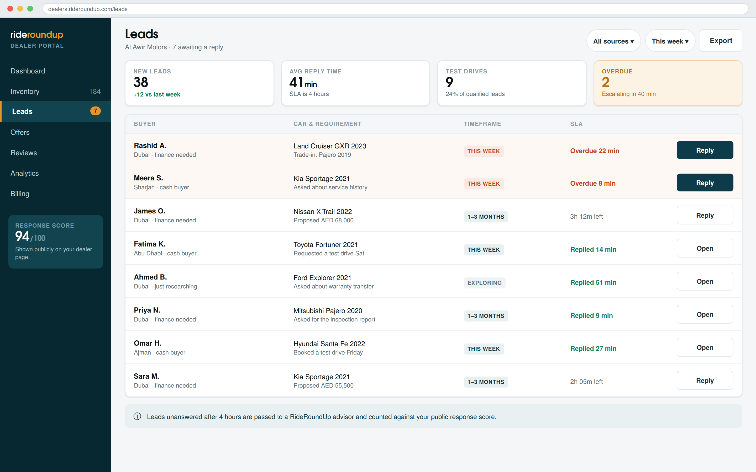
SCREEN 08
Dealer portal
The revenue side. Dealers pay for qualified leads, so qualification is visible.
Requirements, not raw clicks
Timeframe, finance need and trade-in travel with the lead. This is what makes it sellable.
SLA timer on every row
Four working hours, then it escalates to a RideRoundUp advisor automatically.
Response score is public
It appears on the dealer’s profile page. Dealers are told this at onboarding.
Overdue is impossible to miss
Two rows tinted, a counter in the stats strip, and a stated escalation time.

Slide 12
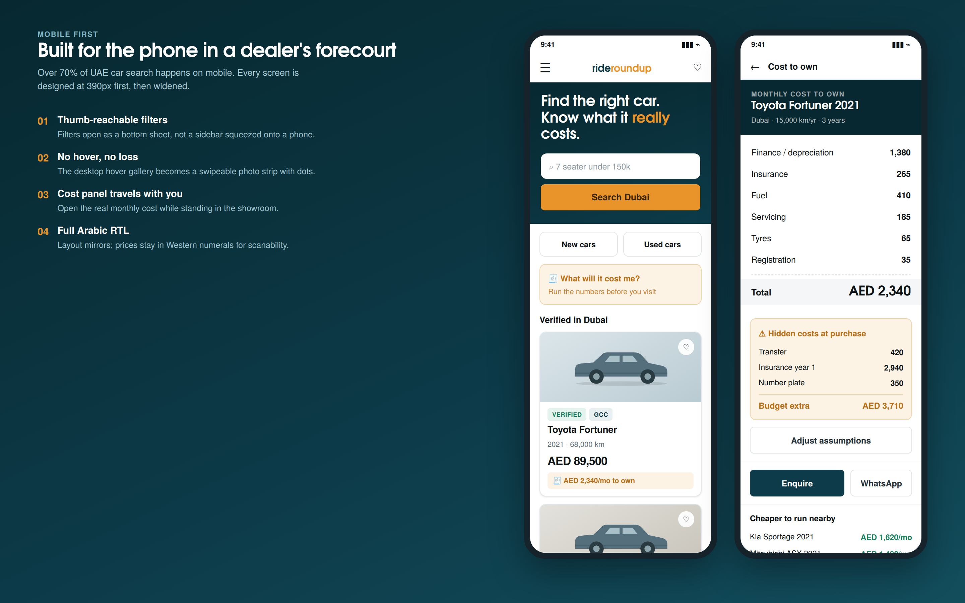
SCREEN 09
Mobile
Designed at 390px first. Over 70% of UAE car search happens here.
Hover has no mobile equivalent
The desktop card gallery becomes a swipeable strip with position dots.
The receipt travels
A buyer can open the true monthly cost while standing on the forecourt.
Filters as a bottom sheet
Never a desktop sidebar squeezed onto a phone.
Arabic mirrors fully
Layout flips; prices stay in Western numerals so they remain scannable.

Slide 13
UI FEEDBACK
Every point in the feedback document, answered
All seven are launch blockers, not polish. A bad navbar and a weak card suppress the click-through the entire business model depends on.
✓
Font and logo should be updated
Geometric wordmark with a standalone monogram; display + body + Arabic companion, all weight-matched.
✓
Navbar has dead space and bad spacing
Six items, 64px, 32px gaps, utilities right-aligned. If items don’t fit, remove items — never shrink type.
✓
Vehicle classification needs sub-headers
Browse hubs by body, budget, fuel, seats and use case. Fixes navigation and becomes the strongest SEO asset.
✓
Cards need USPs and hover images
Derived USP chips plus a four-image marquee on 300ms hover intent, with reduced-motion respected.
✓
Cleaner UI, Carvana as reference
Whitespace, one action per card, restrained colour and large legible pricing — taken. The layout is our own.
✓
Community and social tagging
Share and Open Graph cards ship now. Moderated forums wait until moderation staff exist.
✓
Financing not needed this phase
Agreed. Calculators and education only — no applications, no partner routing.
Notes:
Paras should sign these off individually before public launch — that is written into the launch gates in the specification.

Slide 14
BUILD SEQUENCE
What gets built, in what order
26 weeks to public launch with a team of six to eight. The data model and the vehicle card block almost everything else — over-invest in both.
Weeks 1–4
Weeks 5–10
Weeks 11–16
Weeks 17–22
Weeks 23–26
Foundations
Catalogue
Differentiator
Intelligence
Launch
Data model, design tokens, component library, vehicle PIM, search index.
Vehicle card, new car pages, used listings, dealer profiles, universal search, comparison.
Cost to Own engine and pages, accounts, saved searches, alerts, minimal Garage.
Dealer portal and SLA, guided finder, AI assistant, CMS, content hub, Arabic pass.
SEO and performance hardening, accessibility, dealer beta, launch-gate verification.
Before Sprint 0 can start
Where does vehicle data come from — licensed feed, manual entry, or both? · Is the current site being replaced or refactored? · Is the logo and typography commissioned? · Which five to ten dealers are in the pilot?
Notes:
The vehicle data source question is the single biggest schedule risk in the project. It needs an answer before engineering starts.

Slide 15
WHAT TO TAKE AWAY
Three things to hold onto
01
Launch the UAE properly before touching India
The catalogue is smaller, the dealers are nearby, and bilingual forces the localisation to be built correctly the first time.
02
Protect the vehicle data model like an asset
Comparison, the assistant, valuation and SEO all inherit its errors. A weak hierarchy is the most expensive mistake available.
03
Ship depth on ten modules, not breadth on twenty-nine
Nothing was cut — it was sequenced. Shallow breadth loses to CarDekho and DubiCars on every axis at once.
Full detail in the written build specification · RideRoundUp_Website_Spec

